Slide 1

Securing repos at scale with the GitHub API and GitHub Applications
Kirk Davis
Solution (code and instructions for use) at:
https://github.com/KirkSampleOrg/Branch-Protector-GHApp-.NET-Lambda

Slide 2
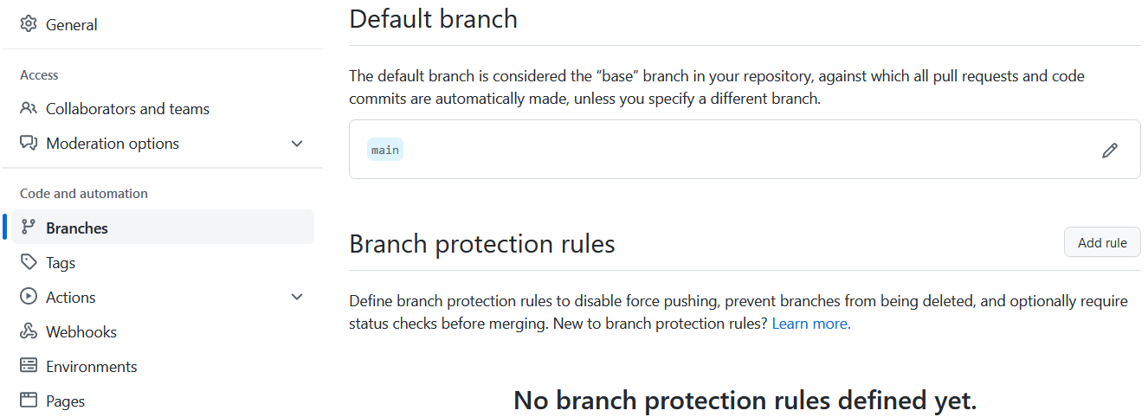
Options to secure branches in GitHub repos
GitHub repos support applying branch-protection rules, such as requiring pull requests and approvals before merging changes
You can view/edit these rules via a repo’s branch settings

Slide 3
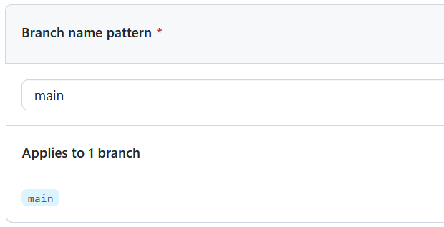
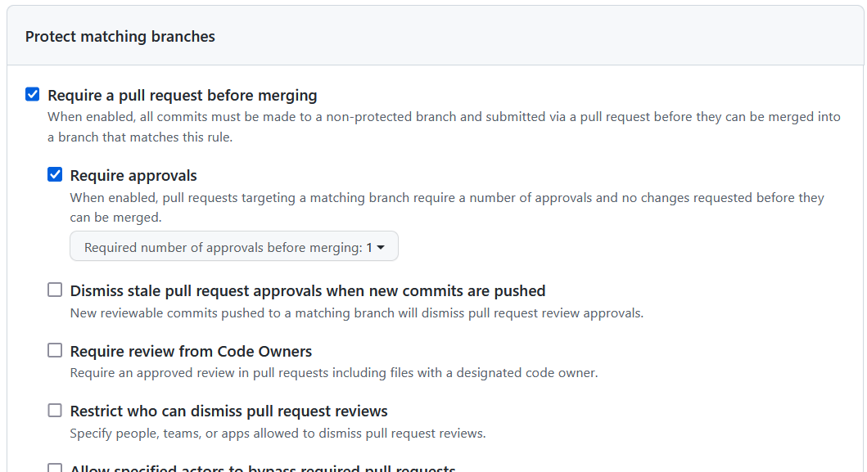
Options to secure branches in GitHub repos
Branch protection rules offer many options, including setting the number of required approvals, and requiring reviews by code owners
Rules can apply to all branches, or branches matching a branch-name pattern at the repo level

Slide 4
Automating branch protections with a GitHub App
GitHub’s API allows you to automate setting branch protection rules (along with virtually everything else in GitHub!)
GitHub Apps are the officially recommended way to integrate your own code with GitHub
GitHub Apps
Can include webhooks triggered by events such as creation of new GitHub repos
Can be installed for an organization, or an account
Can be secured by validating the webhook, and authenticating with digitally-signed JSON Web Tokens (JWT)
Can interact with the GitHub API using an SDK

Slide 5
Automated solution overview
This solution implements the logic in C# (.NET 6), deployed as a serverless function in AWS
The function is invoked by the webhook (HTTP POST), which includes a digital signature that is verified
The function ensures there is a default branch, applies branch protections, and creates an issue in the new repo that provides a link to the branch protection applied

Slide 6


Automated solution - details
All code for this solution and instructions to implement it in GitHub are at: https://github.com/KirkSampleOrg/Branch-Protector-GHApp-.NET-Lambda
The code includes a method, SendNotification(string messageBody), that publishes a message to an AWS SNS topic if enabled
This solution relies on AWS Lambda environment variables, which are encrypted at rest, to store the GitHub App’s private cryptographic key and webhook shared secret
The code uses the Octokit Client Library for .NET to interact with the GitHub API
Users can create new repos without creating a default branch; to ensure the default branch exists:
The code fetches a list of all the branches, and checks for the default
If there is no default branch, the code uses the Repository contents API to create a readme file at root, specifying the default branch name

